Slide 1


Team members:
1.Rahat Alfaz Abir (19203103105)
2.MD. Polash Islam (19203103075)
3.Samia Prome Sarker(19203103081)
4.Md Emtiyaj Uddin Emon(19203103089)
5.Wahida Ashrafi Oishi (192031031066)
Under the supervisions of,
Atiya Masuda Siddika,
Lecturer,
Department of CSE,BUBT

Slide 2


Overview of the project
To make finding university easier for the Students.
To save time and let the students focus more on their study.
Over 100 University information to chose from.
Recent news’s about admission and university.
Subject review’s to help students chose the best subject for them.

Slide 3



Motivation
Admission war
1.Students find it very hard to look for university information and choosing between them
For example:
cost
location
GPA

Slide 4
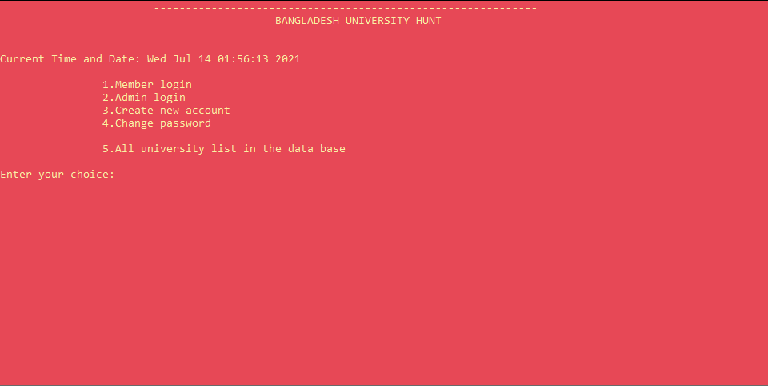
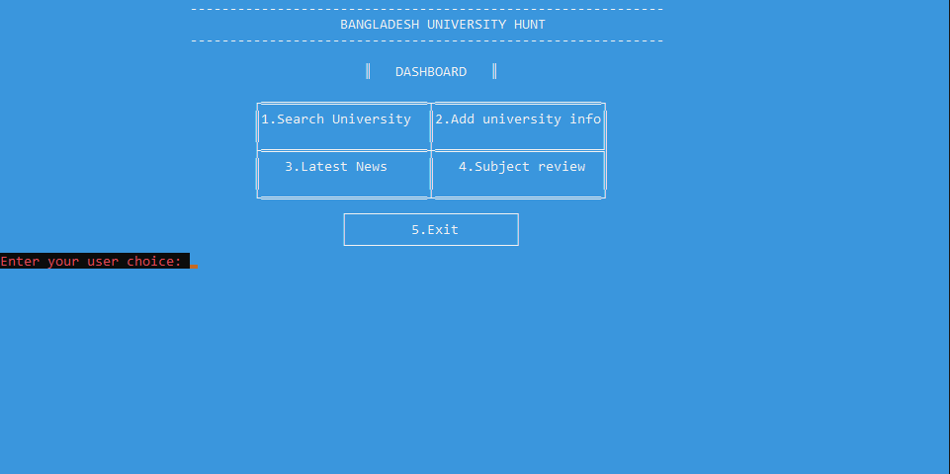

Required analysis
Finding the popular universities among the students
Collecting different types of data about those universities
Categorizing them by location, required GPA and total cost
How to make a community by introducing more options for help
How can we make the system user friendly
How to make approving new information easy for the admins
Before login
After login

Slide 5

Key features
_______________________________________________________________________________________________________________________
University information:-
University name, Rank, Location, Vice-Chancellor, faculty’s, tuition fee,
minimum required GPA, extra facilities, university website.
_______________________________________________________________________________________________________________________
_______________________________________________________________________________________________________________________
Search a University:-
by name, by location, by required GPA, by cost
_______________________________________________________________________________________________________________________
_______________________________________________________________________________________________________________________
User added university info:-
Ask for new university information to admins, add new university information by user
_______________________________________________________________________________________________________________________
Latest news about admissions:-
Recent news’s about university admission exam or results
_______________________________________________________________________________________________
Subject review:-
Popular subject reviews to help the students chose better subjects
_______________________________________________________________________________________________
Update the latest news from console, notification from newly asked
university information, Approve or edit new added information by
the user, update the subject review section.
Admin access:-
_______________________________________________________________________________________________

Slide 6
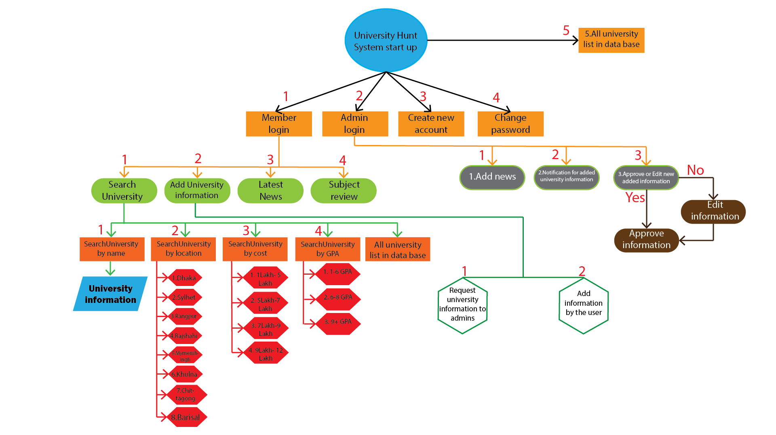
System Diagram
System diagram 1

Slide 7
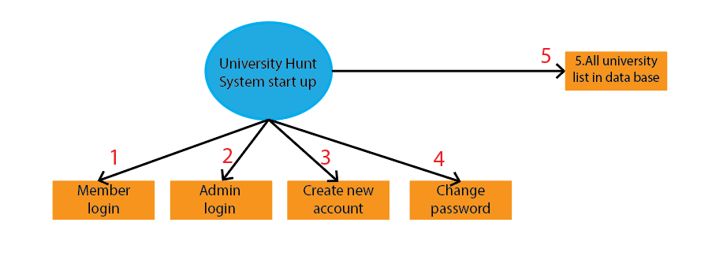
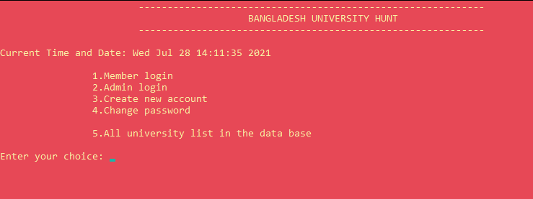
System start up diagram
System start up on console

Slide 8
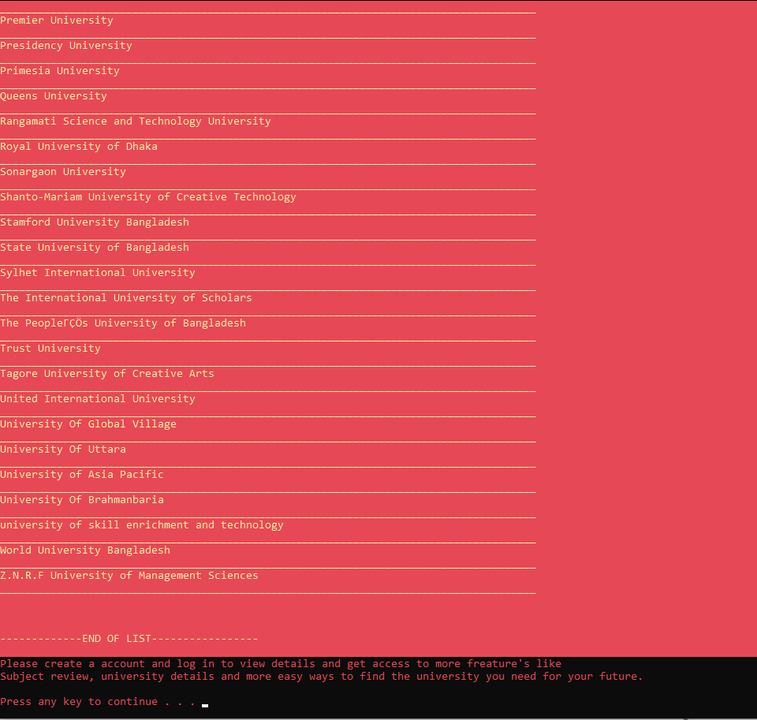

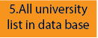
All university list in console view

Slide 9
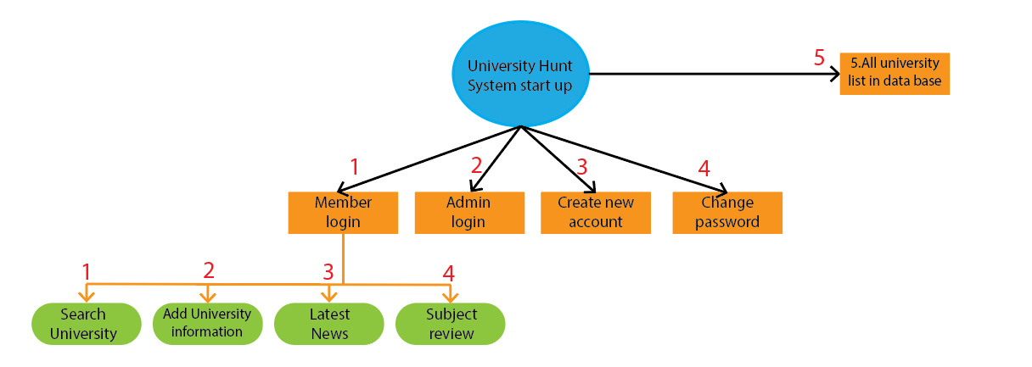
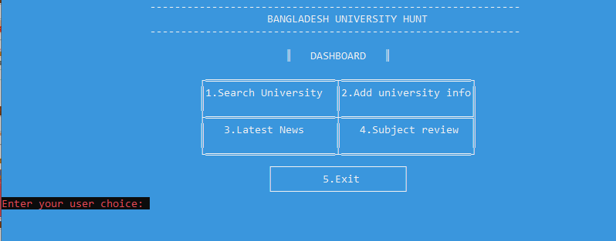
Dashboard diagram
Dashboard console

Slide 10
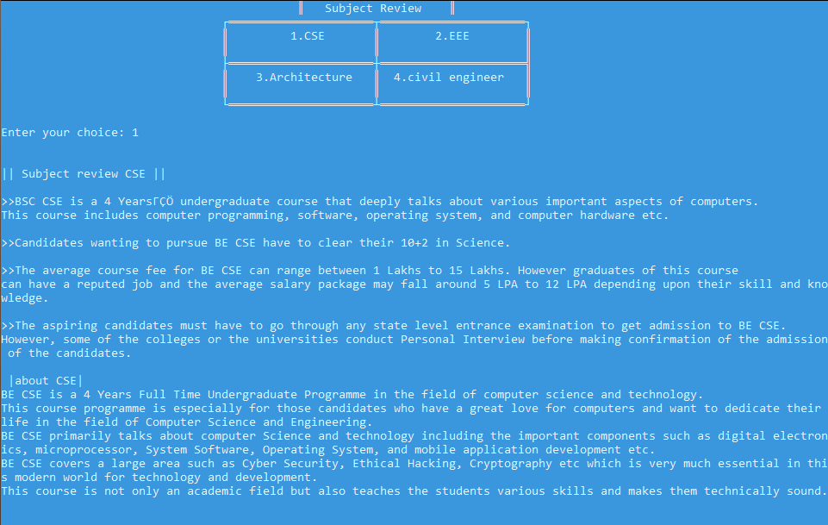

Subject review console

Slide 11
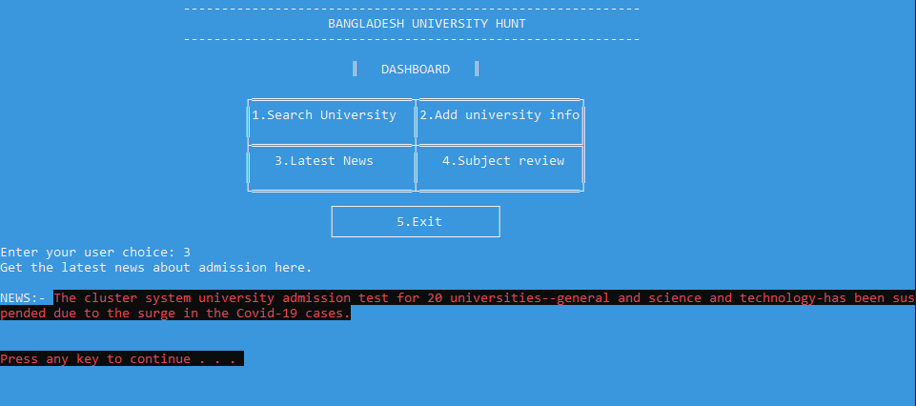

Latest news console

Slide 12
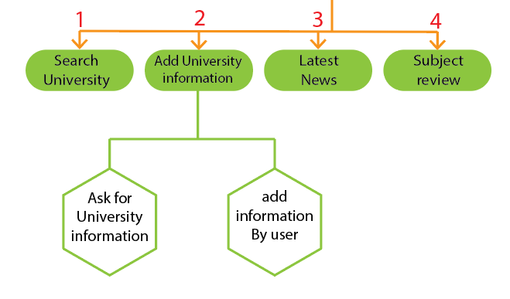
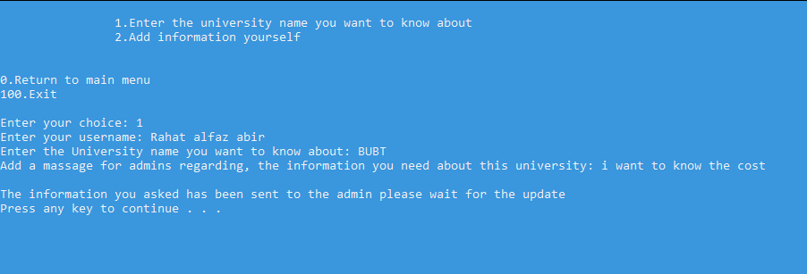
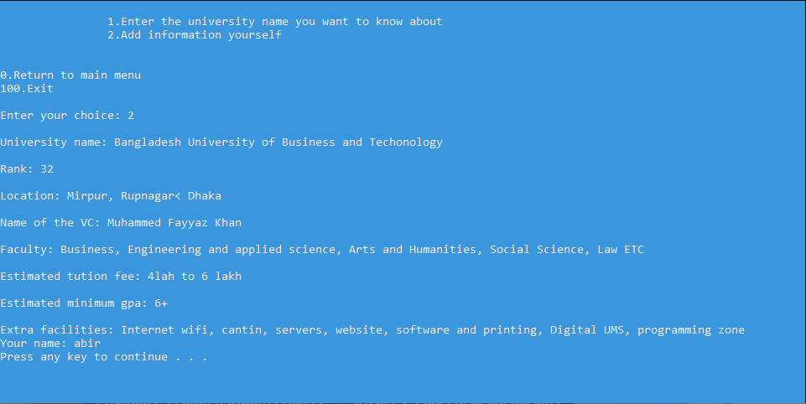
Add university information Diagram
Ask University information console
Add information by user Diagram

Slide 13
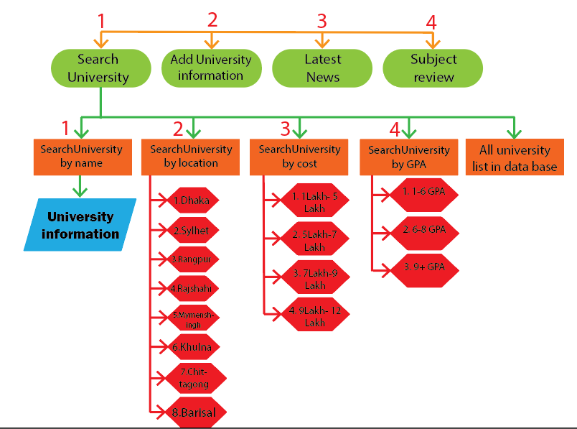
Search University Diagram

Slide 14

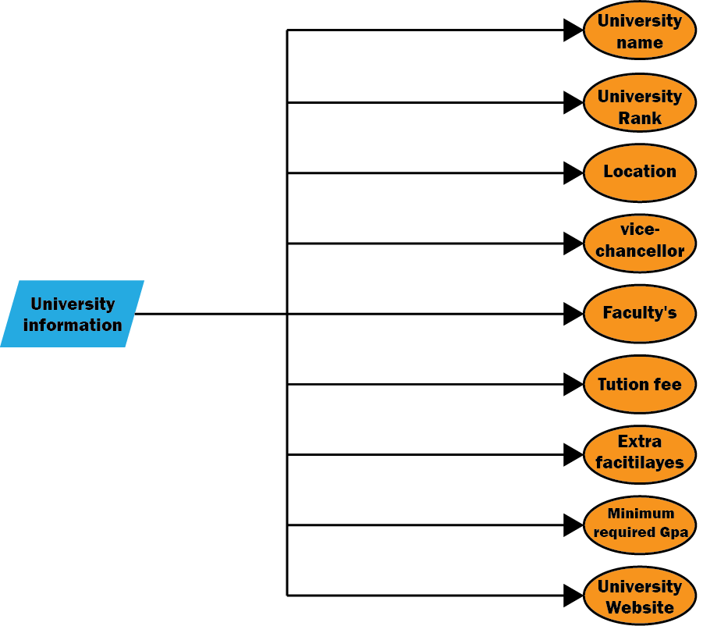
System Diagram
System diagram 2

Slide 15


Implementation
Software requirement for(Developer)
Install Code;blocks
Install GNU GCC complier and required extensions for Code;blocks
Hardware requirement for(User)
A Computer that has any version of windows installed in it.
Processor:1GHz(recommended)
Ram:500mb(minimum)
Disk:100mb(will be sufficient)
Any windows supported Integrated development environment (IDE)
Implementation

Slide 16


Advantages
Over 100 University information including public and private
User id system to keep the program secure
Categorized University list
Users can request a university information or add them by themselves
Data management with admin access
Update news section
Get notifications
Approve add or edit new added university information
Advantages

Slide 17

Limitations
Can not edit university information from console
Can not edit subject review sections from console
Only Works offline
Needs constant admin support to update requested information
Limitations

Slide 18


Future Plan
Adding Graphical user interface
Eliminate every manual data input and management, make the whole program console based
Add more university to the data base
Providing online support
Interduce AI to show the information based on user search
Overall make the program more visually appealing and user-friendly
Future Plan

Slide 19

Conclusion
Our program ensures accurate, fast and useful information.
easy to use, good looking, informative and user friendly experience.
We made sure the university information we put in our database is correct and from the main website
we carefully categorized all the university
We hope to continue our project and keep making it better everyday.
In the end we hope that our program gives the students the information they want and helps them focus more

Slide 20


Slide 21


